Slide 1
Stegnography USING SHA
Presented By:
NAME – Polepalli Prasanna
COLLEGE NAME - Malla Reddy Engineering College For Women
DEPARTMENT – CSE(IOT)

Slide 2
OUTLINE
Problem Statement
System Development Approach
Algorithm & Deployment (Step by Step Procedure)
Result
Conclusion
Future Scope
References

Slide 3
Problem Statement
This project focuses on securely hiding and transmitting secret text by embedding it in images using steganography and verifying its integrity with SHA-256 hashing. The hidden text is encrypted before embedding, and upon extraction, it is decrypted and validated using the hash to ensure it hasn’t been tampered with.

Slide 4
Proposed solution
The system allows hiding secret text (including Hindi/Unicode) inside image files using LSB steganography.
The input message is encrypted before embedding for confidentiality.
The combined encrypted message and hash are hidden in a PNG or BMP image without altering its appearance.
During extraction, the hidden data is retrieved and decrypted.
The hash is recalculated from the extracted message and compared with the embedded hash.
If the hashes match, the message is confirmed as authentic and untampered; otherwise, a warning is shown.

Slide 5
System Approach
Software Requirements:
Operating System: Windows 11
Language: Python (3.13)
IDE: VS Code
Hardware Requirements:
Processor: Intel i5 or higher
RAM: Minimum 16GB
Hard Disk: 512 GB or more

Slide 6
Libraries used
PIL (Pillow - PIL.Image):Provides easy handling of image files in various formats like PNG and JPEG. Supports image loading, saving, and modification.
PyCryptodome:A Python library for cryptographic operations Used to perform AES encryption and decryption of the secret text before and after hiding it in the image.

Slide 7
Algorithm & Deployment
Encoding Phase:
Input: User enters a secret message (supports Hindi/Unicode).
Hashing: Generate a SHA-256 hash of the original message.
Concatenation: Combine message and hash as: full_data = message + "::" + sha256_hash
Binary Conversion: Convert full_data to binary.
Steganography (LSB):
Embed the binary data into the least significant bits of image pixels (RGB values).
Output: Save the image with hidden data.

Slide 8
Decoding Phase:
Input: User loads the encoded image.
Bit Extraction: Read binary bits from LSB of image pixels.
Binary to Text: Convert binary data back to text
Split Data: Separate message and embedded hash using the :: delimiter.
Hash Verification:
Recalculate the SHA-256 hash of the extracted message.
Compare it to the embedded hash.
Output:
If hashes match: display message.
If not: show integrity warning.

Slide 9
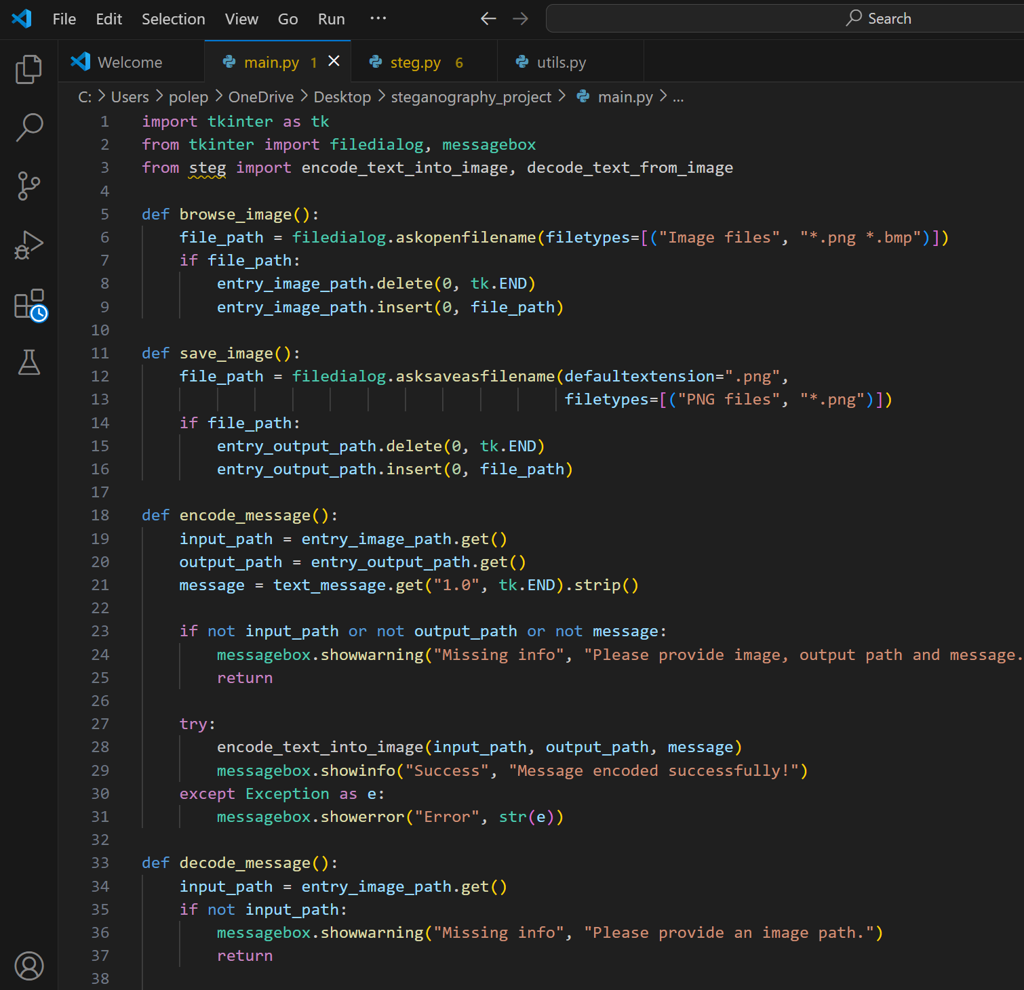
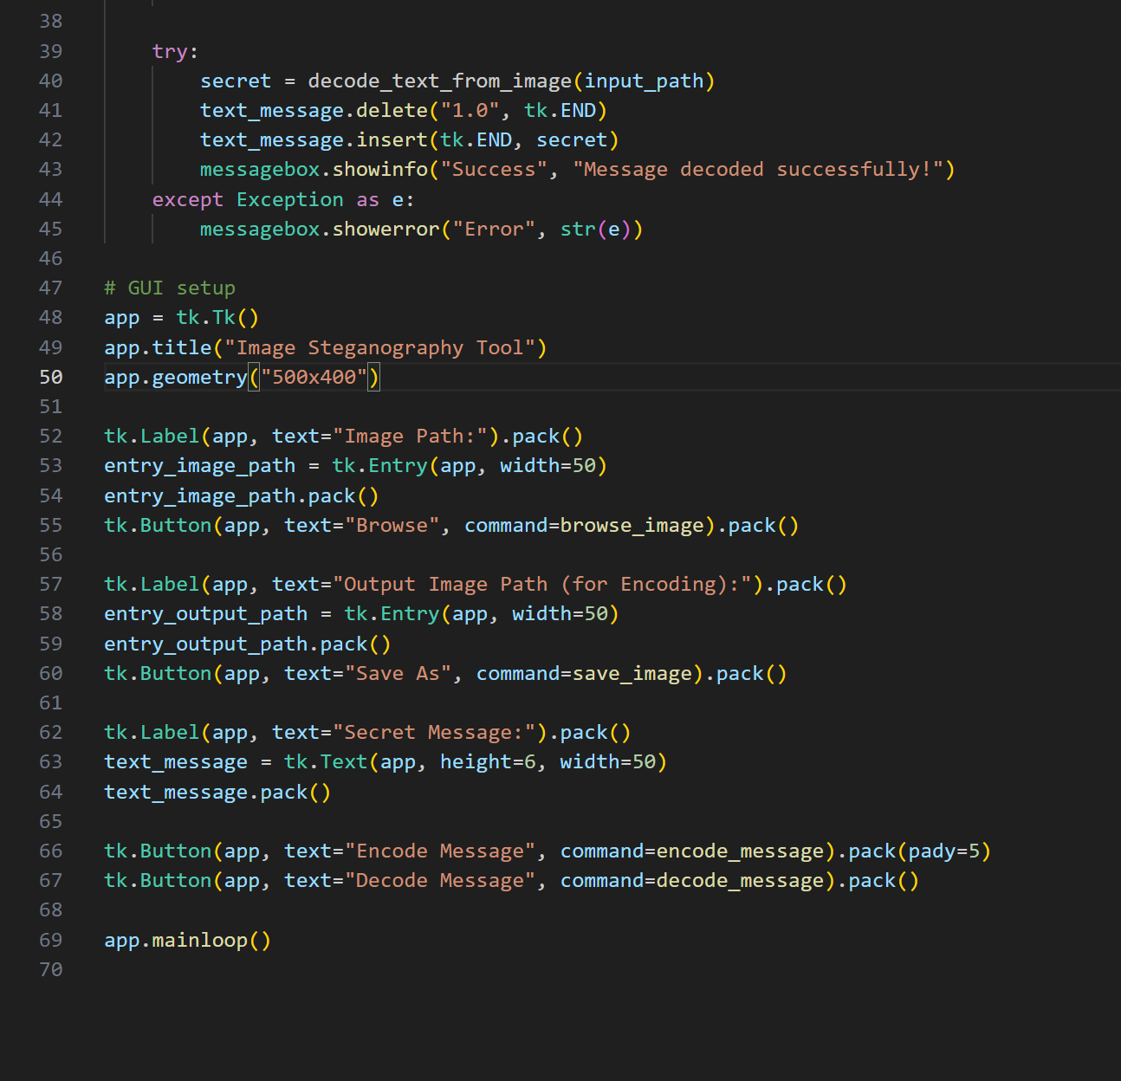
Result
CODE

Slide 10

OUTPUT SCREENS

Slide 11
GITHUB REPOSITORY LINK
https://github.com/Prasanna-polepalli/stegnography-using-SHA.git

Slide 12
Conclusion
The steganography project using SHA-256 provides a secure method to hide and transmit secret messages within images. By combining LSB-based image steganography with SHA-256 hashing, the system ensures both confidentiality and integrity of the hidden message. The inclusion of a user-friendly GUI and support for Unicode (e.g., Hindi text) makes it accessible and practical for real-world use. Overall, the project successfully demonstrates how cryptography and steganography can be integrated to create a reliable tool for secure digital communication.

Slide 13
Future scope(Optional)
Add AES or RSA encryption for enhanced message confidentiality.
Develop a web-based version using Flask or Django for online access.
Create a mobile app for Android/iOS to make it portable and easy to use.
Support video and audio steganography for hiding data in multimedia files.
Use AI/ML to detect steganalysis attempts and improve stealth.
Enable batch processing for multiple images or messages at once.
Integrate image compression handling to support JPEG steganography safely.

Slide 14
References
Pillow Documentation – Python Imaging Library used for image manipulation 🔗 https://pillow.readthedocs.io/
PyCryptodome Documentation – Python library for cryptographic operations 🔗 https://www.pycryptodome.org/
Python hashlib Library – Built-in Python library for hashing algorithms (SHA-256) 🔗 https://docs.python.org/3/library/hashlib.html
Tkinter GUI Documentation – Python standard library for GUI development 🔗 https://docs.python.org/3/library/tkinter.html
LSB Steganography Technique – Common method for hiding data in images 🔗 https://en.wikipedia.org/wiki/Steganography#Digital_steganography
SHA-256 Algorithm – Secure hashing algorithm used for integrity verification 🔗 https://en.wikipedia.org/wiki/SHA-2

Slide 15
THANK YOU - POLEPALLI PRASANNA

